Slide 1
Building Mantid packages with Conda
Tom Hampson
Mantid developer workshop
October 16th 2023

Slide 2
Outline
Why did we move to Conda?
How do we use Conda in Mantid?
How to build Mantid Conda packages and distribute them to users
Focus on what is useful for developers
Outline a few issues – good for discussion

Slide 3
Why Conda?

Slide 4
Mantid before Conda
Third party dependency management varied significantly on different OS:
Windows: self-maintained git repository of dependencies
macOS: Homebrew package manager, pip
Linux: OS provided packages

Slide 5
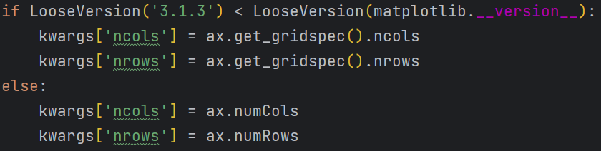
Why was this bad?
Adding a new dependency was a significant amount of work
Needed to maintain multiple dependency management systems
Difficult/impossible to define consistent versions of libraries across the project
Ended up with a lot of version checks within the code

Slide 6
Why did we choose Conda?
Cross-platform
Support for C++ and Python
Many popular Python packages were already using it
Conda-build is provided to enable building packages
meta.yaml file provides central place to define dependencies
Easy to define dependency versions
Version definitions stored alongside the code in the repository

Slide 7
How are we using Conda?

Slide 8
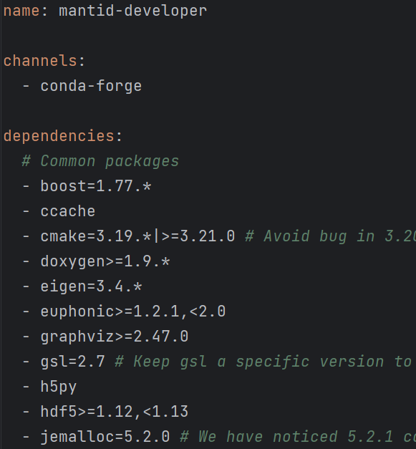
1. Developer environment
Basically a list of dependencies required to build/run mantid
All from conda-forge channel

Slide 9
1. Developer environment
Create mantid-developer Conda environment:
conda env create –f mantid-developer-linux.yml
Creates a developer environment where you can build mantid
Used in our build/test PR check and nightly pipeline
Easy to add new dependency or update an existing one

Slide 10
2. Conda-build recipes
Used for building Conda packages
A flat directory containing:
meta.yaml – metadata for the recipe
build.sh or build.bat – build script for macOS/Linux or Windows
run_test.py – optional python test script that runs automatically
We have conda recipes for four packages:
mantid
mantidqt
mantiddocs (noarch package)
mantidworkbench
Stored in the mantid repo inside conda/recipes

Slide 11
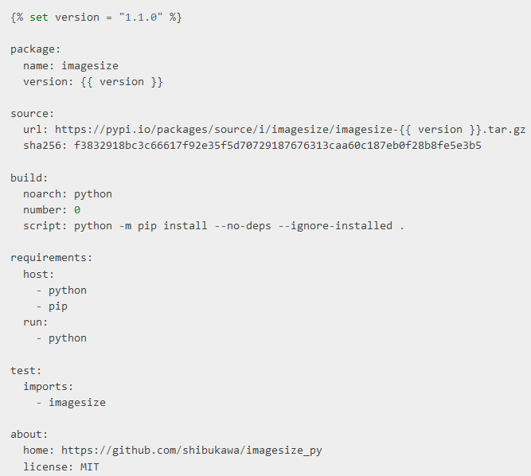
Example meta.yaml

Slide 12
Mantid Conda recipes
Most of you will not need to touch these
Important to note that the developer environments are not used when building packages
If you add a new dependency, it must be added to developer environments and Conda recipes, otherwise packages won’t build
Any version specification goes into conda_build_config.yaml
If you’re unsure, ask in conda-support or conda-development slack channels
Dependencies need to be on conda-forge channel

Slide 13
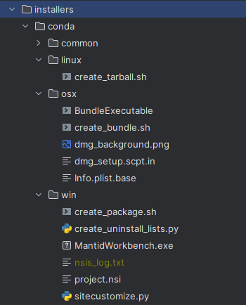
Standalone packages
Set of scripts that run after Conda packaging
Install mantidworkbench into a Conda environment
Package all files up into OS specific installer/bundle/tarball
End user needs to know nothing about Conda

Slide 14
Building Conda packages

Slide 15
How to build mantid Conda packages
Logic for building Conda packages can be found inside package-conda script:
buildconfig/Jenkins/Conda/package-conda
You can run it directly:
buildconfig/Jenkins/Conda/package-conda $WORKSPACE --build-mantid
--build-qt --build-docs --build-workbench
Packages will be placed in
$WORKSPACE/conda-bld
Better option is to ask Jenkins to do it for you

Slide 16
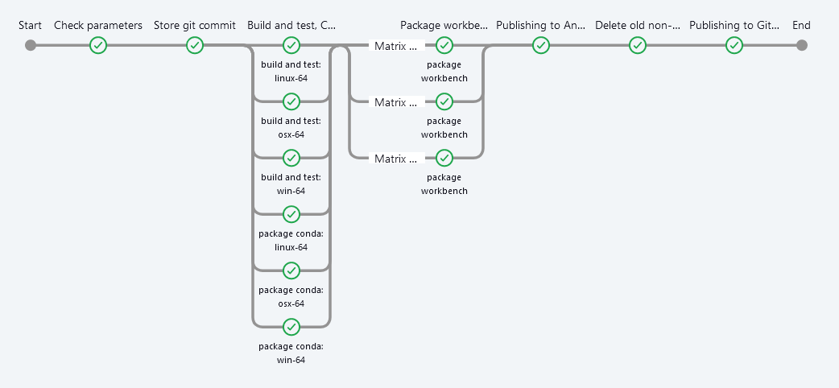
Jenkins Conda packaging pipeline
Uses the nightly_build_and_deploy.jenkinsfile declarative pipeline

Slide 17
Building packages on Jenkins
Navigate to the build_packages_from_branch Jenkins job
Click “Build with parameters”
Change the BUILD_PACKAGE variable to whatever you need
Fill in the BRANCH_NAME field
(adjust other fields if you’re using a fork)
Click “Build”
Wait
It will archive a standalone mantidworkbench installer/package along with the conda packages.

Slide 18
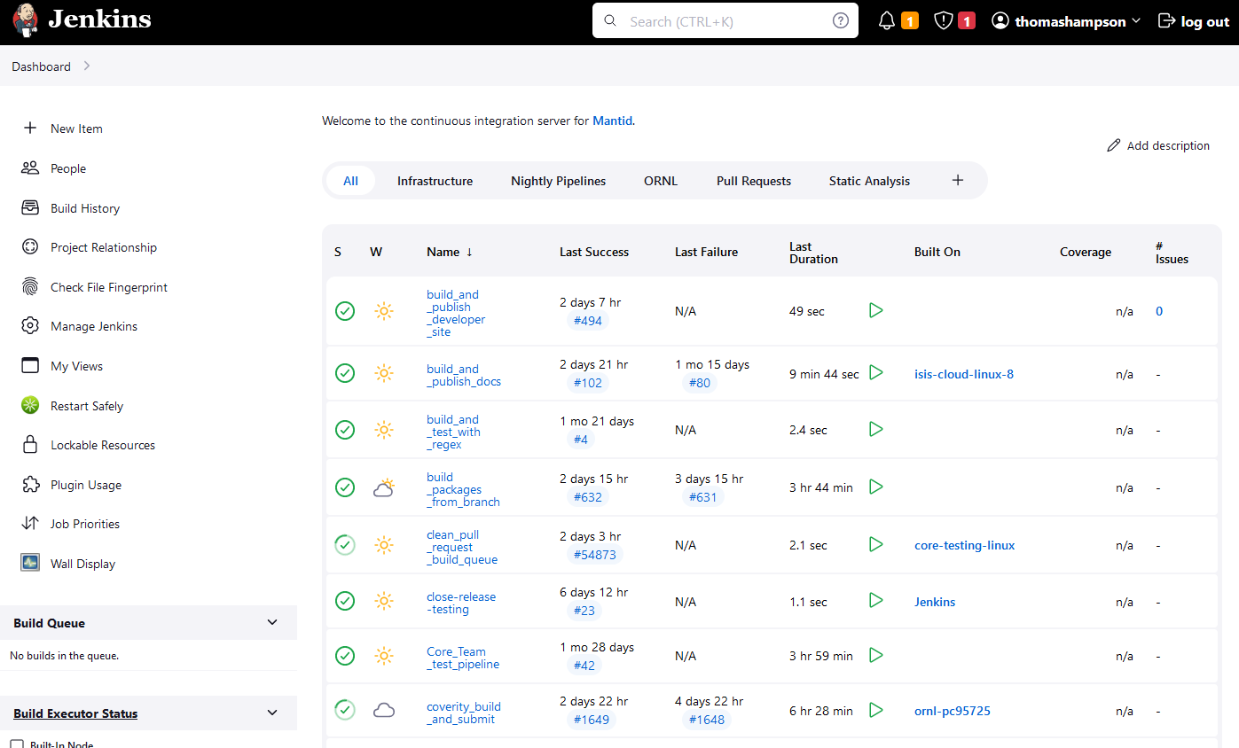
Building packages on Jenkins

Slide 19
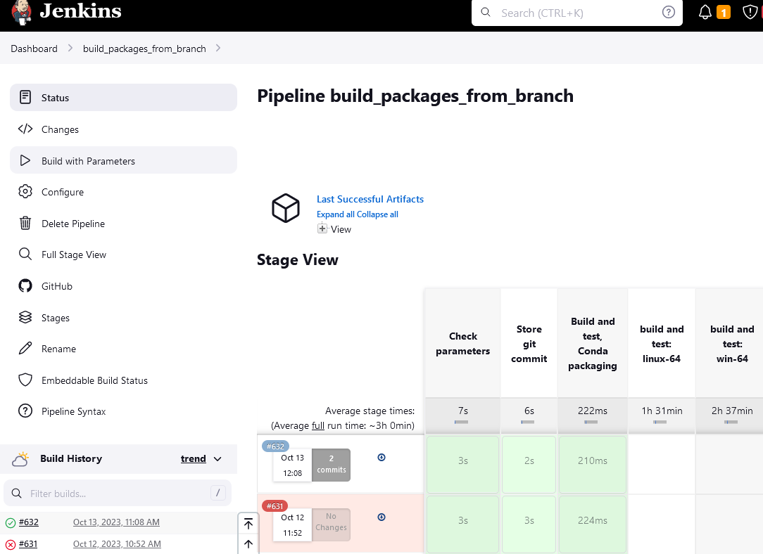
Building packages on Jenkins

Slide 20
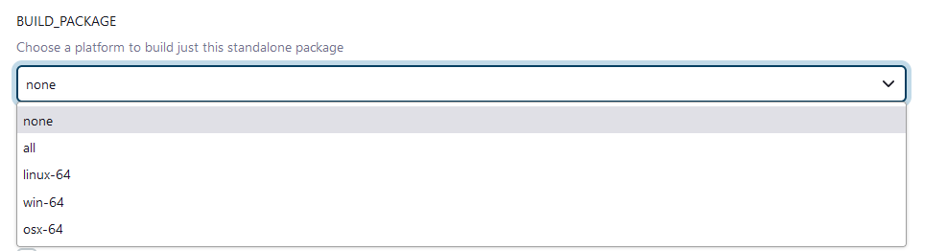
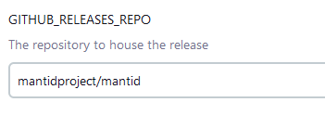
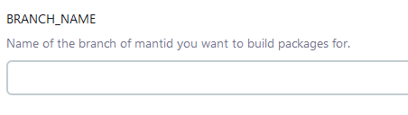
Building packages on Jenkins
Change this if you’re working on a fork

Slide 21
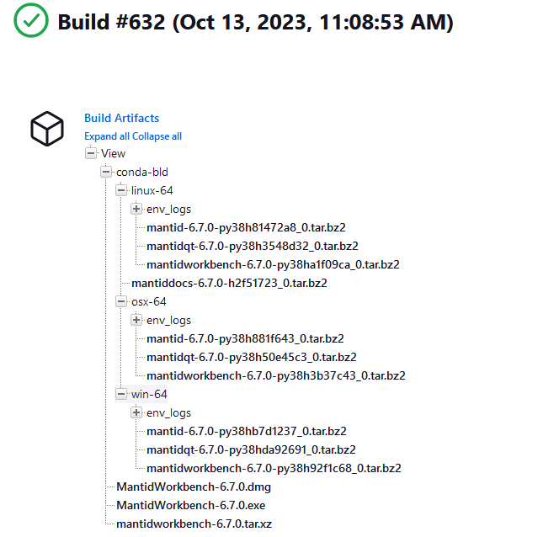
Building packages on Jenkins
Conda packages
Standalone packages

Slide 22

Uploading Conda packages to anaconda
For users/developers to download and test
Can upload directly to the mantid channel via the Jenkins job by ticking the checkbox
Not recommended
You won’t have the permissions to remove it
We have already exceeded our plan’s storage limit

Slide 23
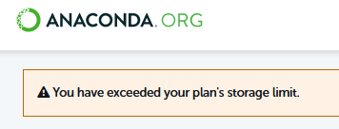
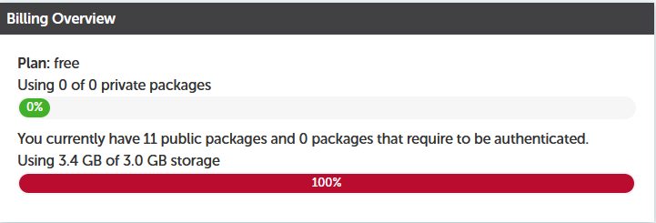
Uploading Conda packages to anaconda

Slide 24
Uploading packages to your own anaconda channel
Create account on anaconda.org
Create new Conda environment for uploading using the Anaconda-client CLI
conda create -n anaconda-upload-env
conda activate anaconda-upload-env
Install anaconda-client
conda install anaconda-client –yes

Slide 25
Uploading packages to your own anaconda channel
Log in with your anaconda account
anaconda login
Download the conda packages from Jenkins into a folder somewhere
Upload them to anaconda with
anaconda upload --label test_label mantid*
Optionally add a label

Slide 26
Installing packages from your anaconda channel
Create conda environment and install using your channel and label
conda create –n manitd_test_env
conda activate mantid_test_env
conda install –c thomashampson/label/some_label mantidworkbench

Slide 27
Issues
ideas are welcome

Slide 28
Issues – numpy support
We build packages against the lowest supported numpy version (1.22)
This is what conda-forge are doing
Allow users to install up to 1.24
Mantid-developer environment currently using numpy 1.24
All tests are run with this version
Do we need to test against all versions that we support?

Slide 29
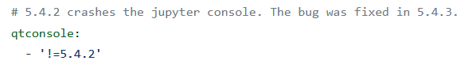
Issues – dependency changes
Sometimes a dependency will update and break our nightly pipeline
Usually either a failing unit test or failing package build
Example:
This was particularly bad, the console was broken in all versions of mantidworkbench because it’s a runtime dependency
We could only fix it for the nightly by introducing the pin
Had to wait for the fix for release versions to work

Slide 30
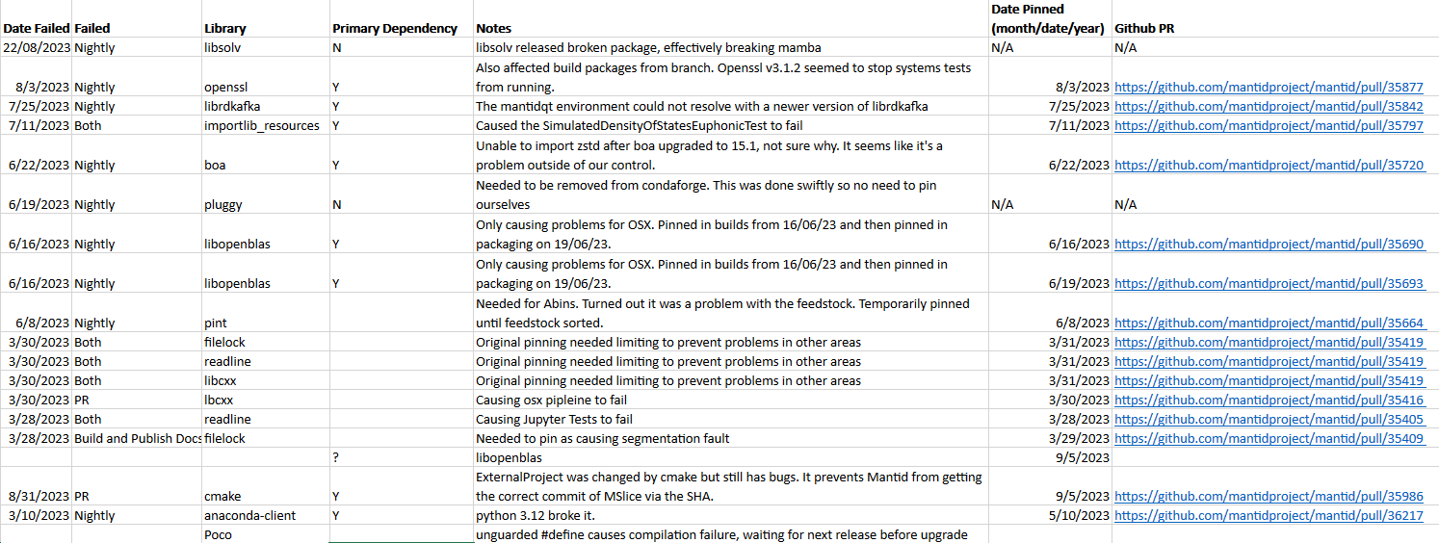
Issues – dependency changes
Started keeping track of these in March this year after we had to pin 6 packages within a single week

Slide 31
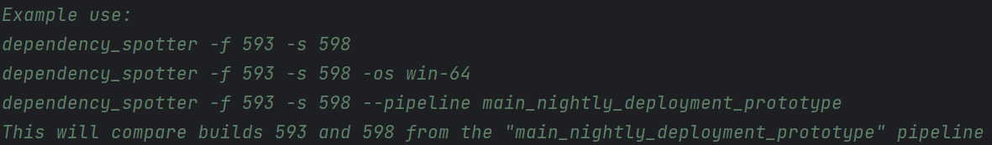
Issues – dependency changes
Protocol now is to pin the dependency to the last known working version
Then create a github issue to investigate and attempt to fix the problem
Created a useful tool to compare Conda environments between given Jenkins builds
Helps us quickly identify suspects
tools/Jenkins/dependency_spotter.py

Slide 32
Duplicated version pinnings
Version pinnings are currently stored in 4 different files:
mantid-developer-linux.yml
mantid-developer-win.yml
mantid-developer-osx.yml
conda_build_config.yaml (for conda build)
Easy for them to go out of sync
There is a maintenance issue to address this, ideas are welcome

Slide 33
Exceeded anaconda storage limit
Not sure how much of a problem this is

Slide 34
Packages not on conda-forge
What can we do if a conda package isn’t on conda-forge?
How can we use pip packages?

Slide 35
Summary - benefits
Easy to define consistent package versions across all OS
Enables us to control when we upgrade, e.g.
Python
Matplotlib
Numpy
Users can easily install additional Python packages into their mantid Conda environments
Simplified developer set up

Slide 36
Thanks!

